Slide 1


Department of ECE
College of Engineering Guindy, Anna University, Chennai
EC5030 – Mini Project
Presentation for the Final Review
17th November, 2025.
DESIGN AND VERIFICATION OF UART COMMUNICATION PROTOCOL USING SYSTEM VERILOG
Under the Guidance of:
Dr. S. R. Sriram
Associate Professor
Department of ECE
CEG Campus, Anna University
Presented by:
Umesh Kanna. K. B (2022105010)
Rubesh K (2022105702)
Jaganath B (2022105522)
B.E - ECE (IVth year)

Slide 2

Layout
Introduction
Project Motivation & Objectives
Literature Review
Inferences from the literature
Proposed Methodology
Time line
Conclusion & Future Work
References

Slide 3
Introduction
UART - Universal Asynchronous Receiver Transmitter
Why it’s called “Universal”?
Because its parameters - speed, data size and so on- are not fixed, and can be configured.
It is used for asynchronous serial communication.
Baud Rate is a measure of the speed of data transfer, expressed as symbol per sec/bits per sec.
Bit rate = No. of bits transferred per sec. Common baud rates: 9600, 4800, 19200, 38400 etc. Frame format is defined as,

Slide 4
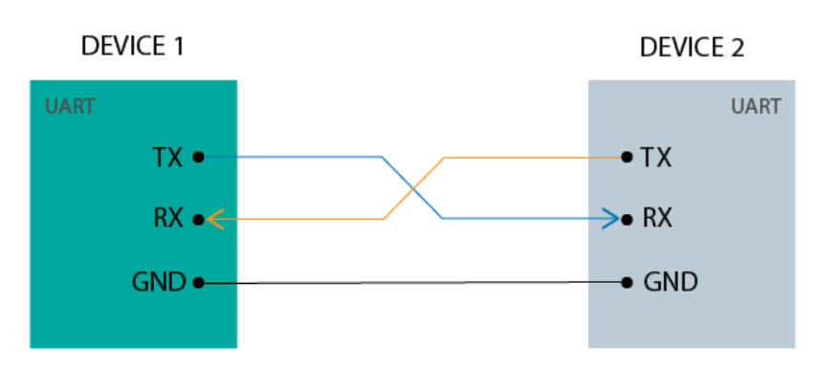
Introduction
UART Communication may be simplex, full duplex, or half duplex
Simplex: One direction only, transmitter to receiver
Half Duplex: Devices take turns transmitting and receiving
Full Duplex: Devices can send and receive at the same time.
Data format and transmission speed are configurable.
Communication goes through the two independent lines/wires.
Fig. Two wire Protocol Communication

Slide 5
Project Motivation & Objectives
Need to design a custom UART Tx–Rx for reliable on-chip serial communication.
Use of an interface-based architecture to simplify signal connectivity in SoC designs.
Implement a baud-rate-accurate Transmitter using cycle counters and bit shifting.
Develop a 16× oversampling Receiver for stable data recovery and noise tolerance.
Apply UVM-like verification to gain industry-relevant skills in functional validation.

Slide 6
Literature Review
SNO | TITLE | METHODOLOGY | NOVELTY/ ADVANTAGES | LIMITATIONS/ DISADVANTAGES | PARAMETERS
1. | Yamini R., Ramya M. V. (2020). “Design and Verification of UART using SystemVerilog.” International Journal of Engineering and Advanced Technology (IJEAT), Vol. 9 Issue 5, pp. 1208–1211 | A full-duplex UART was designed and verified using SystemVerilog. The design included transmitter, receiver, baud-rate generator, and FIFO modules. A reusable verification environment was developed using agents (driver, monitor, sequencer, scoreboard) with randomized test sequences and SystemVerilog Assertions (SVA) for checking protocol behavior. Simulation was done using QuestaSim. | - Achieved 100% functional coverage and 100% assertion coverage. - Implemented randomized verification to test corner cases automatically. - Created a reusable verification environment for multiple UART DUTs. - Demonstrated reduced verification complexity and time using SV. | - No synthesis or FPGA implementation (simulation-only validation). - Focused on standard UART; lacks multi-protocol or configurable-baud validation. - Dependent on QuestaSim simulator; not evaluated on hardware timing or power | - Coverage: 100% (assertion + functional) - Testbench: SystemVerilog (QuestaSim) - Verification type: Constrained random + assertion-based - Operation mode: Full duplex UART
2. | Vikash Prajapati, Alpana Pandey (2025). “FPGA based UART Design: Simulation, Synthesis & SystemVerilog Functional Verification.” IEEE GC-ON Conference, 2025 | Developed a multi-UART architecture on Nexys 4 DDR FPGA supporting multiple baud rates (9600–230400 bps). The design integrates Baud Rate Generator, Transmitter, Receiver, and Debouncing logic. Verification was performed using SystemVerilog testbench with Assertions (SVA) and Functional Coverage in QuestaSim. Hardware demonstration was done via RS-232 communication and Tera Term interface. | - Implemented multi-UART with configurable baud rate on FPGA. - Verified using SVA + coverage-based verification achieving 100% correctness. - Hardware-in-loop validation on Nexys 4 DDR board. - Low latency and accurate full-duplex data transfer. - Combines design, synthesis, and verification in a unified flow. | - Limited to fixed oversampling rate; scalability to high-speed interfaces untested. - Demonstration restricted to single FPGA board. - No power or resource optimization reported. - Focused mainly on UART; not generalized to other serial protocols. | - Baud rates: 9600–230400 bps - FPGA: Nexys 4 DDR (Xilinx) - Simulation tools: Vivado, QuestaSim - Coverage: 100% functional and assertion - Interface: RS-232 via Tera Term terminal

Slide 7
Literature Review
SNO | TITLE | METHODOLOGY | NOVELTY/ ADVANTAGES | LIMITATIONS/ DISADVANTAGES | PARAMETERS
3. | Sravani S., & Srujana R. (2023). “Design and Verification of Autoconfigurable UART Controller.” International Journal of Research in Engineering and Technology (IJRET) | Developed an autoconfigurable UART controller using Verilog HDL and verified through SystemVerilog testbench. The system automatically adjusts to various baud rates, data lengths, and parity configurations without manual reprogramming. Verification was performed with assertion-based simulation to validate data integrity and synchronization. | - Automatic configuration of UART parameters enhances flexibility. - Eliminates manual setup for baud rate, stop bits, and parity selection. - Verified using SystemVerilog assertions ensuring protocol accuracy. - Provides adaptability for heterogeneous communication systems. | - No FPGA hardware validation reported. - Limited verification coverage data provided. - Power/resource efficiency not evaluated. - Tested for basic UART configurations only. | - Baud rates: 9600–115200 bps (adaptive) - Simulation: QuestaSim - Verification: Assertion-based SV - Features: Auto-configuration, error detection

Slide 8
Inference from the literature Review:
The parameterized Tx matches literature-recommended flexible UART IP design
16× oversampling in my Rx aligns with proven reliable sampling methods.
Using a SystemVerilog interface reflects modern modular SoC integration practice.
Shift-register framing in Tx/Rx follows standard low-area UART architecture.
The self-checking verification flow mirrors industry-preferred validation methods

Slide 9
Methodology - Design
Defined UART interface signals for modular Tx–Rx integration.
Implemented parameterized Tx with accurate clock–baud division.
Designed shift-register–based framing for start, data, and stop bits.
Built 16× oversampling logic for stable mid-bit sampling in Rx.
Used bit and sample counters to manage receive FSM transitions.
Integrated Tx and Rx using a clean SystemVerilog interface (uart_if).

Slide 10
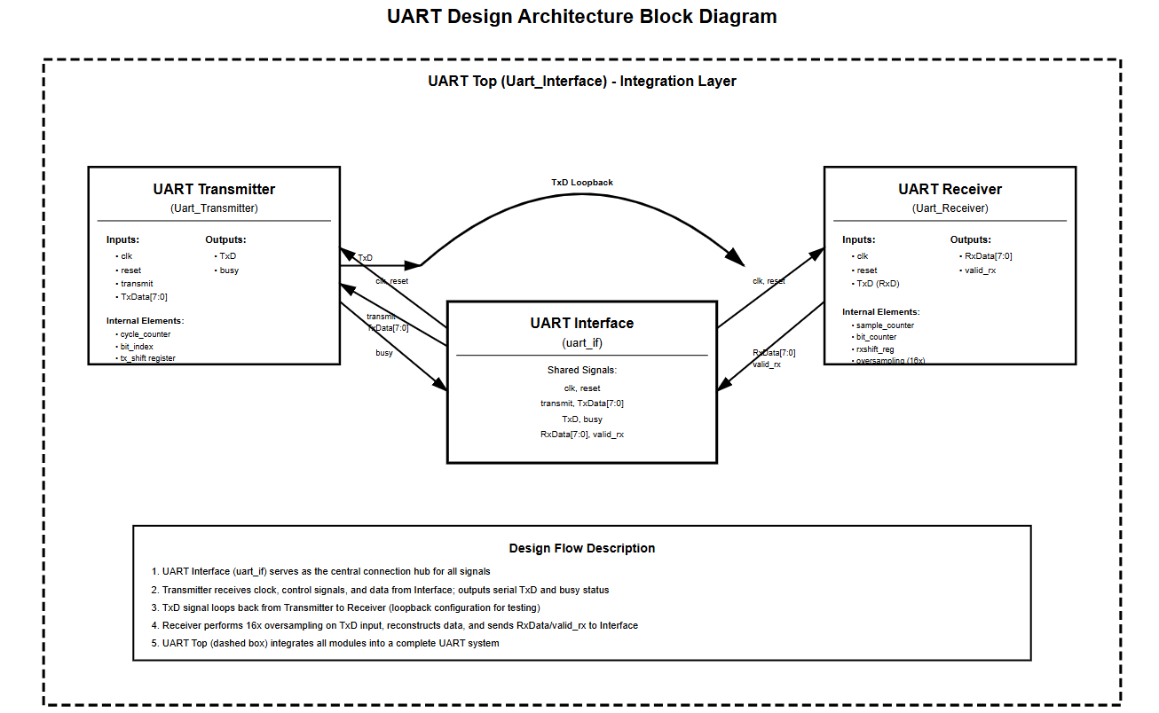
Design Architecture

Slide 11
Methodology - Verification
Created transaction objects to generate UART stimulus.
Used Generator → Driver → DUT flow with mailbox-based communication.
Used Monitor to capture valid_rx events and received bytes.
Built a self-checking Scoreboard to compare TxData and RxData.
Ran parallel processes (g, d, m, s) using environment orchestration.
Verified complete loopback operation by observing matching data streams

Slide 12
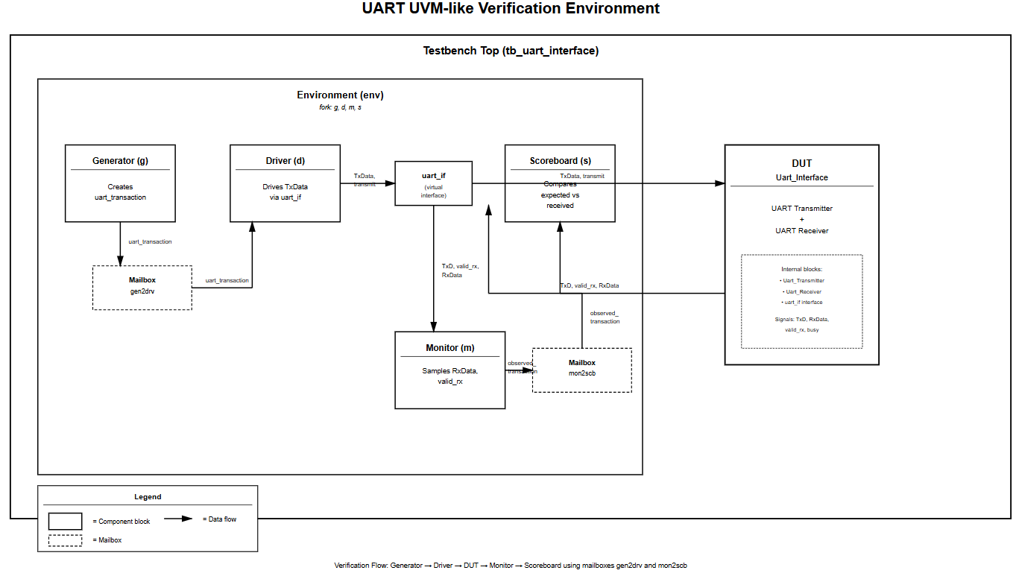
Testbench Architecture

Slide 13
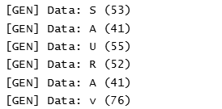
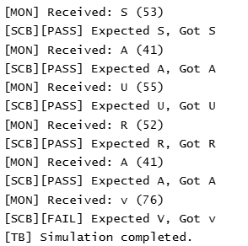
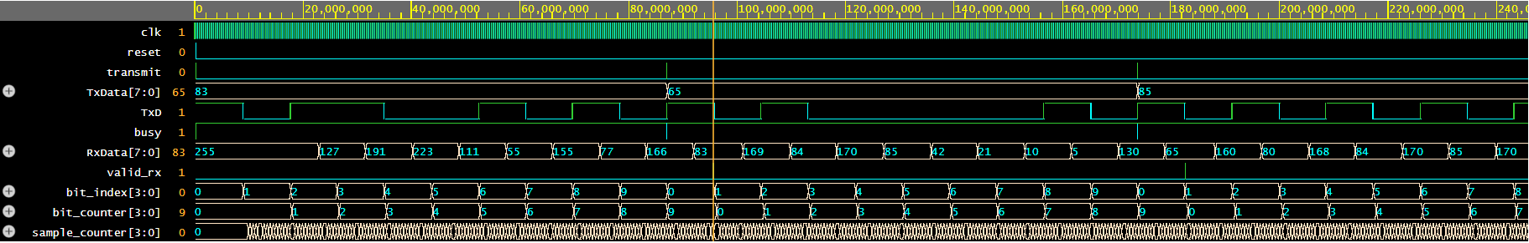
Result
Fig. Console Output and Waveform visuals

Slide 14
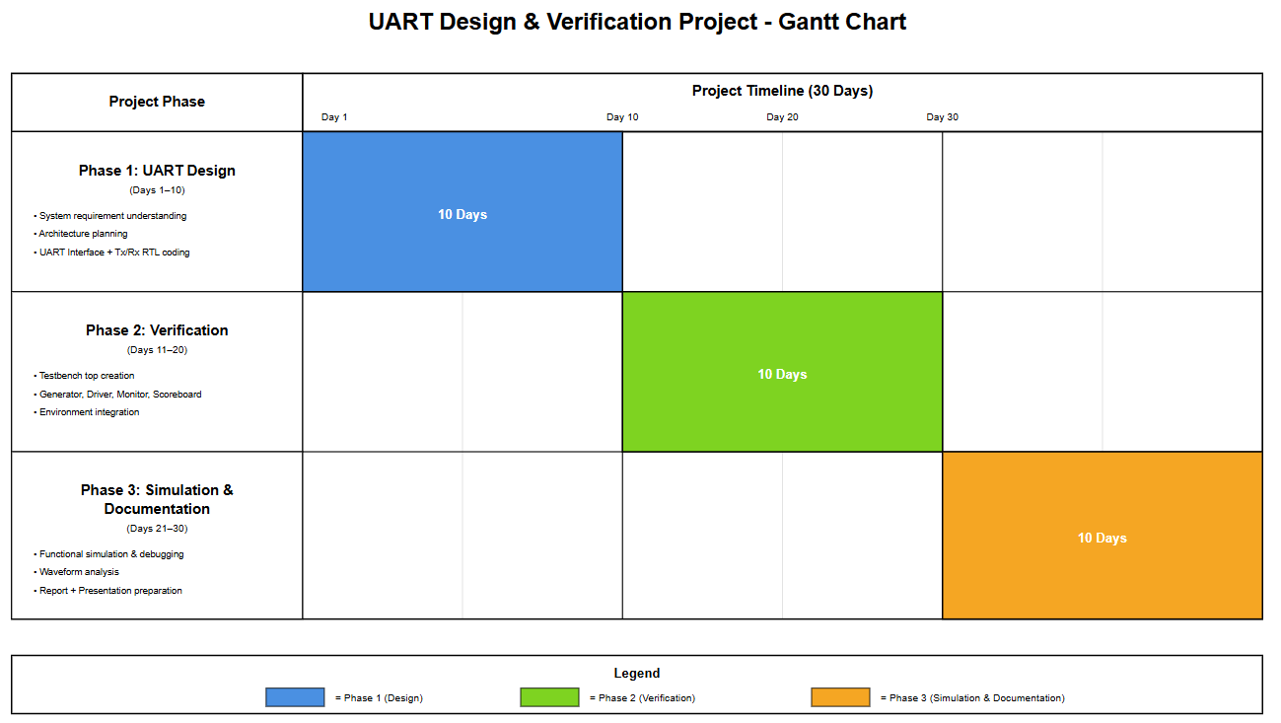
Timeline

Slide 15
Conclusion
Successfully designed a modular UART Tx–Rx using a clean interface structure.
Implemented accurate baud-rate timing and stable 16× oversampling in the receiver.
Verified complete Tx–Rx loopback using a structured UVM-like environment.
Achieved correct data reconstruction with reliable valid_rx signaling.
Testbench ensured self-checking validation through mailbox-based transactions.
Project demonstrated end-to-end functionality with consistent waveform results.

Slide 16
Future Work
Add parity bit support and configurable frame formats for wider protocol use.
Introduce error detection flags for framing, parity, and overrun conditions.
Integrate small FIFOs to support burst data transmission and reception.
Expand verification with random stimulus and corner-case timing variations.
Extend design for higher baud rates and multi-channel UART support.

Slide 17
References
1. Wei Ni, Xiaotian Wang, “Functional Coverage-Driven UVM-based UART IP Verification”, IEEE 11th International Conference on ASIC (ASICON), 21 July 2016.
2. Kumari Amrita, Avantika Kumari, “Design And Verification Of Uart Using Verilog Hdl”, International conference on Recent innovations in Management, Engineering, Science and Technology, RIMEST, 2018.
3. Spear, Chris, Tumbush, Greg, “SystemVerilog for Verification” Book.
4. Doron Bustan, Dmitry Korchemny, Erik Seligman, Jin Yang, “SystemVerilog Assertions: Past, Present, and Future SVA Standardization Experience”, IEEE Design & Test of Computers, Volume: 29 , Issue: 2 , April 2012.
5. Renduchinthala H H S S Prasad, Ch. Santhi Rani, ”UART IP Core Verification by using UVM”, International Journal of Industrial Electronics and Electrical Engineering, ISSN: 2347-6982, Volume-4, Issue-7, Jul.-2016
6. Mahat, Nennie Farina. "Design of a 9-bit UART module based on Verilog HDL." Semiconductor Electronics (ICSE), 2012 10th IEEE International Conference on 2012.
7. Ambika, Prof. Anuradha S, “High Speed UART Design Using Verilog”, International Journal of Advanced Research in Computer and Communication Engineering Vol. 5, Issue 2, February 2016.

Slide 18


